Slide 1
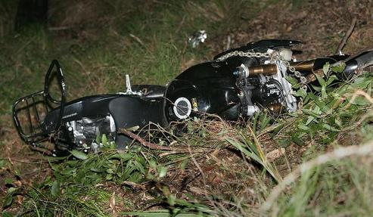

A Blow, A Kiss

